Slide 1
VREX Biometrics
Vamsi Potluru
Rick Ruiz
Gene Chipman

Slide 2
What problem are we solving
A painless way to create and activate TV profiles
Enable personalized features
Home screens or best channel on startup
Personalized results (recs, search, saved, last 9)
Favorites and UI customization
Social media profiles (like for Tweet This)
Enable authenticated features
Parental controls
Home security features
Transactions (PPV purchase, credit cards use)
Explicit and implicit profiles
Implicit profiles automatically adjust results based on user
This requires a soft touch to not spook users
Cannot be used for authentication features
Explicit profiles can be very simple to create
Biometrics will enable automatic login to an existing profile

Slide 3
Why Biometrics
What biometrics can do
Match an utterance to one voice user in a household
Identification – moderate accuracy bar
Learn how many voice users are in a household
Improves identification accuracy
Verify that an utterance is from a specified user
Authentication – high accuracy bar
Challenges of biometrics
Accuracy dependent of duration of speech sample
Both for algorithm learning and identification/authentication
Up to 1 minute of speech needed to learn users
That’s a long time to talk just to create a profile
5-10 seconds of speech needed to recognize users
Typical vrex utterance is 1-2 seconds

Slide 4
Trained vs Clustering
Trained - supervised learning
Requires samples where the speaker is known
Nuance SDK
Fixed phrase (“my voice is my password”)
Free speech (lower accuracy)
Clustering - unsupervised learning
Can use samples of unknown speakers
Can determine number of speakers in a household
Can be applied to existing utterance data
Lower accuracy
i.e., more samples needed
Incorporate vrex metadata (time of day, action, etc)
Improved accuracy

Slide 5
Implicit Profile Creation
Background clustering on utterance data
Determine # of users in household
Collect enough data for moderate accuracy
Two possible ways to ID users
Using just clustering
By training Nuance free speech on clustered data for each user
Nuance ID algorithm *may* work better

Slide 6
Explicit Profile Creation
Background clustering on utterance data
Determine # of users in household
Collect enough data for marginal accuracy
Prompt for profile creation
When clustering accuracy reaches a threshold
Profile creation with a short dialogue session
Profile responses come from a known user
Use Nuance SDK with free speech training
Train on session response + clustered data for that user
Dynamically adjust session length for accuracy
Ask interesting and useful questions during session
Favorite movies, shows, genres, channels, teams
Automatically log in users when identified on usage
Or prompt user to confirm login for marginal cases

Slide 7
Research Steps (Green is completed)
Pull existing vrex data for ‘known’ users
Annotation of users (office folks only)
Mobile device users
Assumed to be the same user most of the time
Experiment with clustering accuracy
Preliminary results presented in next slides
Experiment with Nuance free speech training
Nuance license in place and system installed
Evaluate Nuance free speech training (in flight)
Add vrex metadata to clustering
Compare clustering vs Nuance for implicit case
Build profile creation UX for explicit case
Employee usage to collect data
Adjust algorithms and thresholds to optimize both cases
Report on data requirements and accuracy for both cases

Slide 8
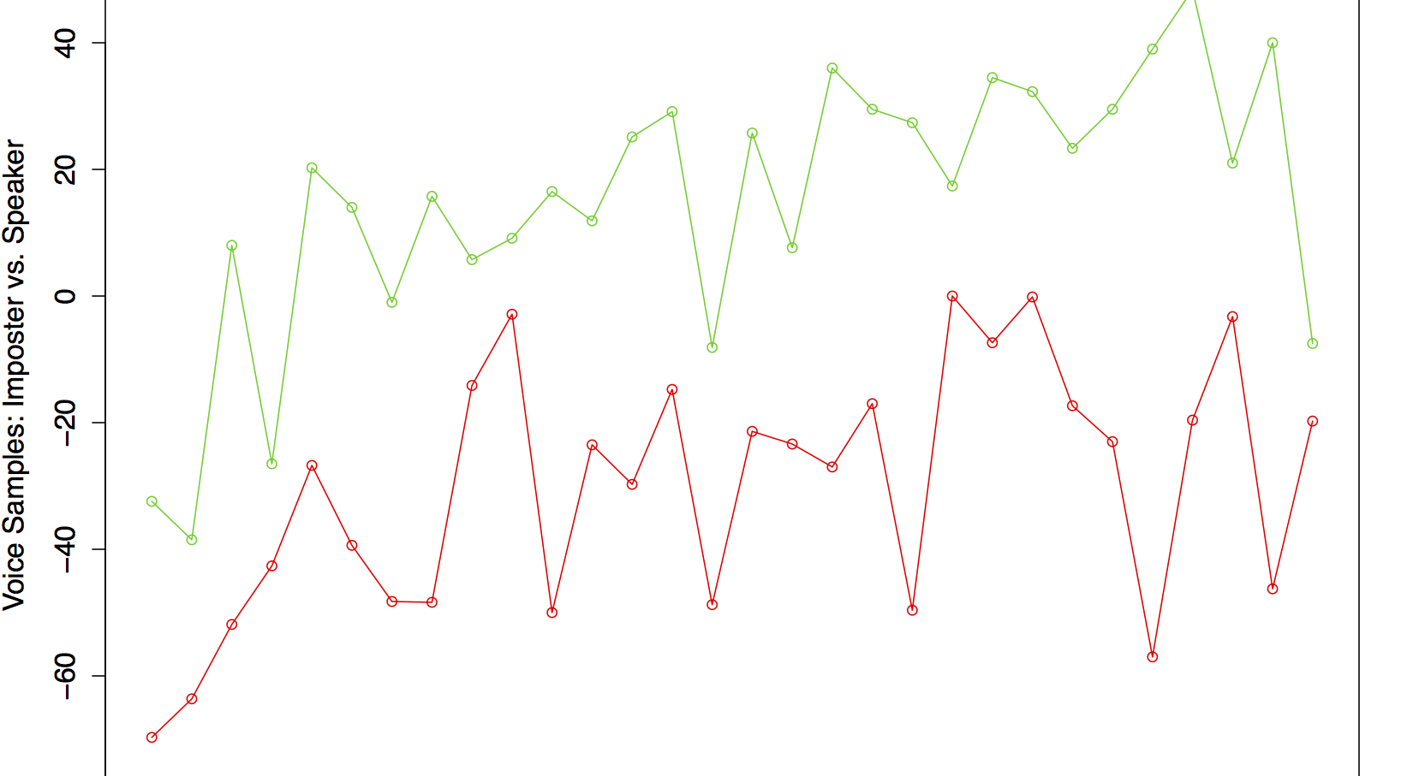
Nuance baseline 1 Speaker

Slide 9
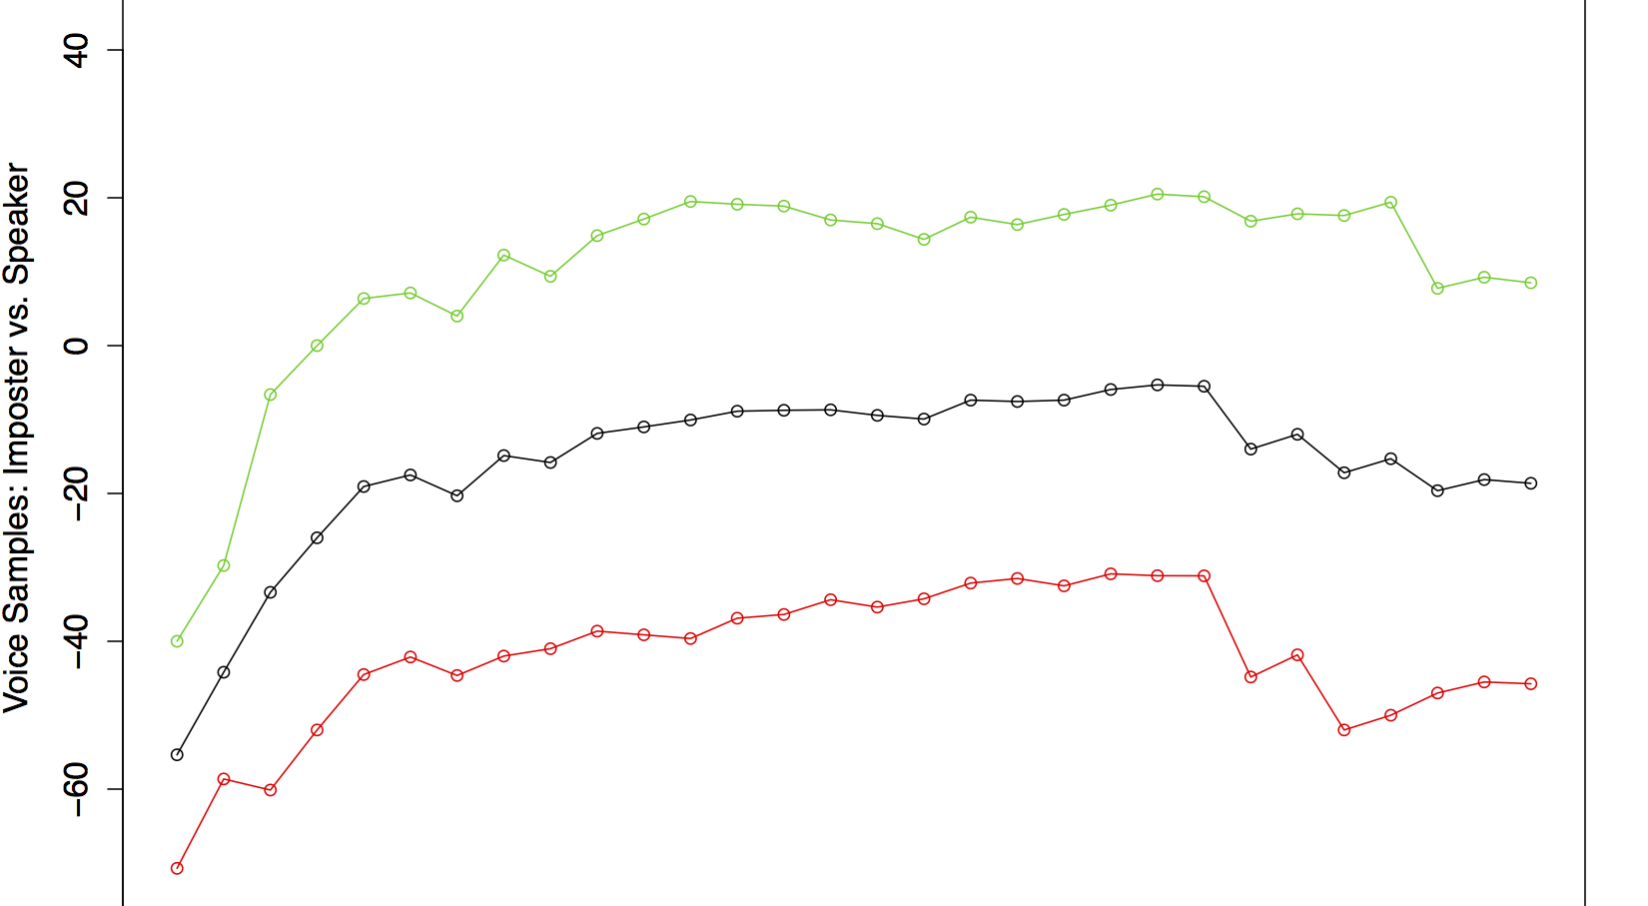
Nuance baseline 1 Speaker, Take II

Slide 10
Nuance baseline
 | errinn rebollar | novella soto | o gabrielle borneman
errinn rebollar | 326 | 3 | 195
novella soto | 11 | 241 | 9
o gabrielle borneman | 8 | 4 | 433

Slide 11
Clustering baseline
 | errinn rebollar | novella soto | o gabrielle borneman
errinn rebollar | 281 | 3 | 64
novella soto | 239 | 1 | 8
o gabrielle borneman | 6 | 287 | 344

Slide 12
Clustering to Nuance
 | errinn rebollar | novella soto | o gabrielle borneman
errinn rebollar | 264 | 117 | 143
novella soto | 244 | 5 | 12
o gabrielle borneman | 15 | 169 | 261

